Slide 1

Library
Management
A Project and Presentation By Priyansh

Slide 2


1. Intro
Library when we first think about it, the picture comes in our mind is a place where’s lot of books are arranged in shelves, but keeping track of all those books can be painful for a person, To Get Rid of that problem we have Library Management Software. Which can
Keeping track of Books It can keep track all books in digitally
Finding Books becomes easier Instead of spend lots of time finding books between shelves, find it easily using digitally.
Efficient Try digitally instead of manually.

Slide 3
2. Motivation
I’ve also suffered how much it becomes much of a hazard of keeping track of books Manually, Or Even finding a book Between thousands of books in Shelves, or what if the record got lost
Which is another kind of thing we can’t Forget, instead if we save all those record Digitally and we can be free from this misery
Because with that we can store it anywhere.

Slide 4
3. Some Details TO BORE.
We’ve already discussed what my software does, Now let us look into some insite that what are the thing it offers:
Add Books into library
When saving it, saves into CSV format so it can be used into other place like MS OFFICE.
Issue Book from library Or Returning it to Library
Also saved as CSV, So can be used for some extended work.
Display all the Books in Library or Issued Books also.
Serialize all the Books in Order of their Specific Number.
As for now, it will be enough.

Slide 5
4. Some Demonstration
In This Section, We will have some demonstration of how does this software work, Before doing that, we get some info about the Project, it consist of 4 files which are
libman.c File (Which contains the program working)
Dependencies.h (contains all the function which are going to be used)
books.csv (contains all the library books)
issued_books.csv (contains all issued books)
With all of these files, the Project can runs seamlessly, no need to have any external header files at all. So Without any further wait let get right into the demonstration.

Slide 6
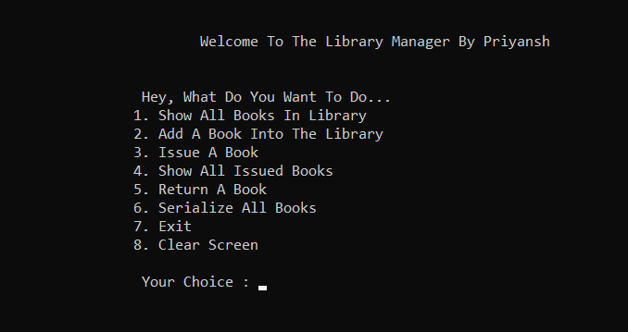
4a. Interface

Slide 7
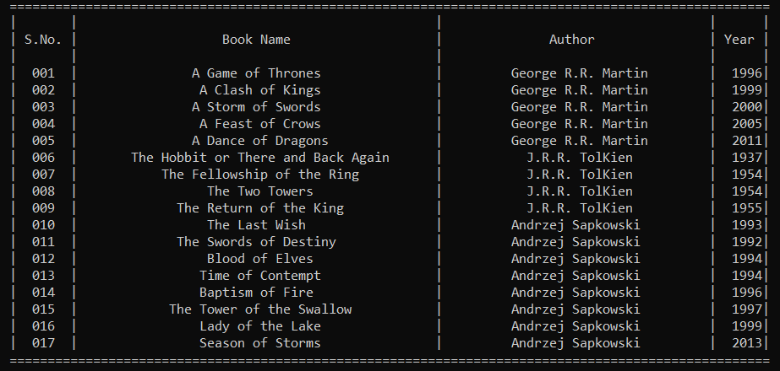
4b. Display All Books

Slide 8
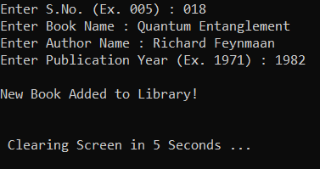
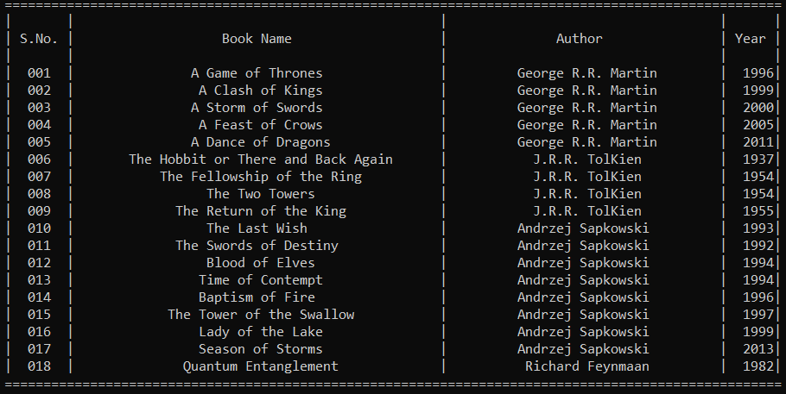
4c. Add Book into Library

Slide 9
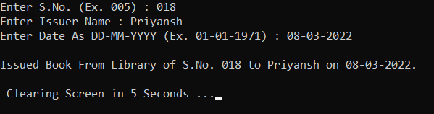
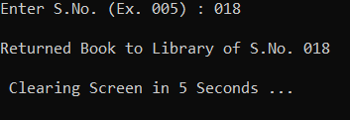
4d. Issue/Return Book

Slide 10
5. End of Presentation
I’ll hope you’ll find it helpful, If you have any query please reach out.
Thank You,
It’s Priyansh, Signing Out daaaa.
You can find the code or other crazy thing on my github.
https://github.com/MrXisOnline/

